Slide 1
A GUIDE TO MOOTING
sponsored by Leo Cussen Centre for Law
PRESENTED BY THE 2021 DIRECTOR OF COMPETITIONS FOR VICTORIA UNIVERSITY’S DICTUM SOCIETY
JAKOB HADENFELD-HUNT

Slide 2
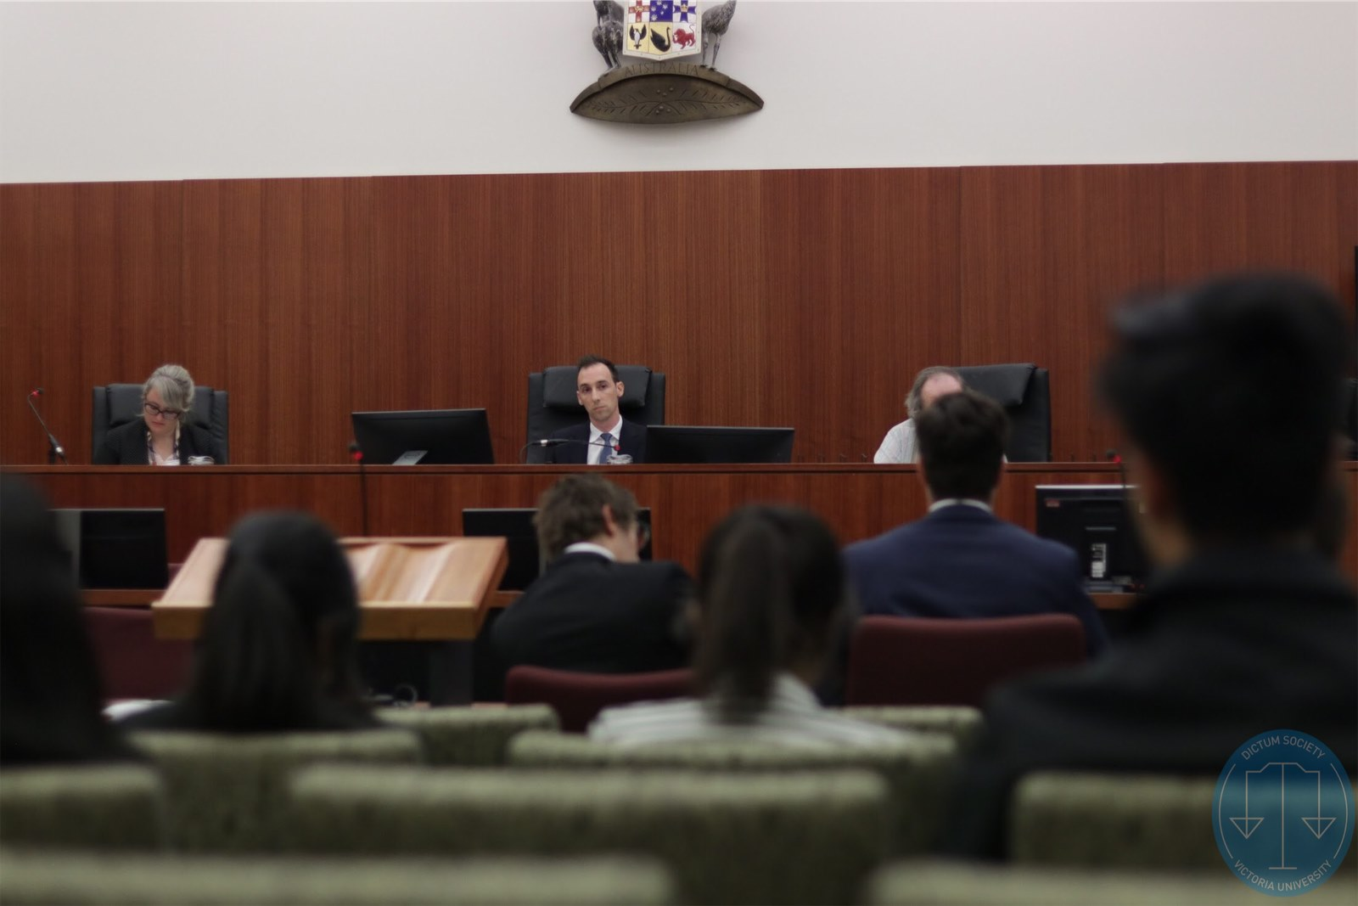
Moots are a unique and excellent opportunity to practice your written and oral skills of legal advocacy.
There are no downsides to participating beyond a matter of time commitment, and with that in mind;
This year’s scheduled moots are intended and designed by myself to be as unobtrusive as possible in regards to the busyness of the 3rd and 4th week in block mode.
This presentation will cover preparation & research and the practicals of mooting.

Slide 3
Preparation & Research
Finding Team Members
General Preparations
Time Management; and
Reading the Problems.
Researching Effectively
Developing your argument
Presentation

Slide 4
Finding Team Members
Can be hard without the ability to meet physically in classes.
Don’t worry about being forced to find a team member, I can pair up spare people. It can be preferable to work with more familiar faces.
I would advise for finding a partner yourself to:
Ask people you’ve worked with previously in legal classes if they or anyone they know would be interested in mooting together;
Ask in your classes, during breaks, at the end, or over the zoom chatroom at the start of class (least disruptive manner possible);
Advertise yourself on university groups on platforms like Facebook, there’s legal chats for VU like the Law Group private group.
Notes:
Finding a group member can be hard in the virtual sphere of things.
Suggestions I would put forward are preferably starting by asking people you’ve worked with previously in legal classes if they or anyone they know would be interested, asking in your classes (probably over zoom’s chat function) or on any relevant university groups you may find on facebook; there’s a law group private group for VU you might have luck in. If you aren’t successful in that, or don’t have the time, it’s likely that I can match you with someone in a similar position, so don’t worry about being unable to participate.
I wouldn’t stress about working with unfamiliar people. For the most part it should actually be easier than group assignments as it is communication just with a single individual who has as strong a vested interest as you do in succeeding. My partner in my last moot was provided by the Director, we communicated and cooperated often and efficiently and met often in the City Queens library to work together. Teamwork was key and our good cooperation saw us win the competition.

Slide 5
General Preparations
Time Management: Moots can involve you committing yourself to understanding specific and new areas of law. You will need to focus on this to do well.
Moot’s Rules & Problems: It is very important to read the presented rules and problems carefully. Specific wording can mean all the difference sometimes for matters of law. Don’t be tempted to skim-read the information before you.
Notes:
Manage your time well, you will need to devote effort if you are looking to succeed, I have attempted to make it as easy as possible to put this effort in without sabotaging your focus on class work. For the most part, the available moots this year should be taking place before 3rd week of block, or after final exams. The dates for each event will be finalised in a time schedule roughly a month or two before information and registration is opened. COVID can make it difficult to have accurate advance schedules and we need to prepare and adjust for that as much as possible. Keep an eye on the Dictum Calendar as the months go by, I aim to have communication as clear as possible for this and my email is always open.
Make sure you read the information very carefully for the competition you’re participating in. The rules and problems can often be long and somewhat tedious and you may be tempted to skim-read. While for the most part the moot problem and relevant matters of law are simple, it can trip people up with the amount of information you can be presented with, and that sometimes you are dealing with an unfamiliar area of law. You want to ensure your arguments when you craft them are specific, accurate, and strong and to ensure that you want to confirm the problem you’re dealing with and the facts to relate them to.

Slide 6
Researching Effectively
The Library and Ebook Central ProQuest are great for finding relevant textbooks.
Three very effective tools for finding cases & statutes:
https://www-westlaw-com-au.
http://www.austlii.edu.au/
http://www2.lexisnexis.com.au/en-AU/Products/casebase-case-citator-online.page
Notes:
The Library and Ebook Central ProQuest are great for finding relevant textbooks to your course and the areas of law the mooting problem may concern, when you can access them. The library might be off limits for now.
Westlaw and Austlii are great resources I use often.
I imagine Austlii will be familiar but Westlaw may not be, I only found out about it myself from my partner in my first moot. You can use Austlii to find specific points of legislation, and Westlaw & Casebase to find relevant cases and precedent.
For instance, if you use Westlaw, you are generally able to access the summary of a case alongside an explanation of relevant matters of law, the precedent cited, and any future cases that have referenced the matter specifically.

Slide 7
Developing your Argument
Communicate with your partner regarding your Mooting arguments.
Ensure you’re employing the relevant legal language for the rule of law you’re debating.
Keep your argument related to the facts presented in the moot, relate the law to the facts and support this with specific statutes and precedent.
Great way to test the strength of your formulated argument is by practicing it against a learned individual.
Notes:
Make sure to communicate with your partner regarding your Mooting arguments.
While the two of you are likely focusing on different rules of law, you will present as a group later and understanding each other’s arguments can help bring a further depth to it.
Keep your argument related to the facts presented in the moot, relate the law to the facts and support this with specific statutes and precedent.
It’s also a great idea to test the strength of your argument by practicing it against your partner or any learned individual who can assist you such as your mooting partner, a volunteering teacher, or a friend also studying law.

Slide 8
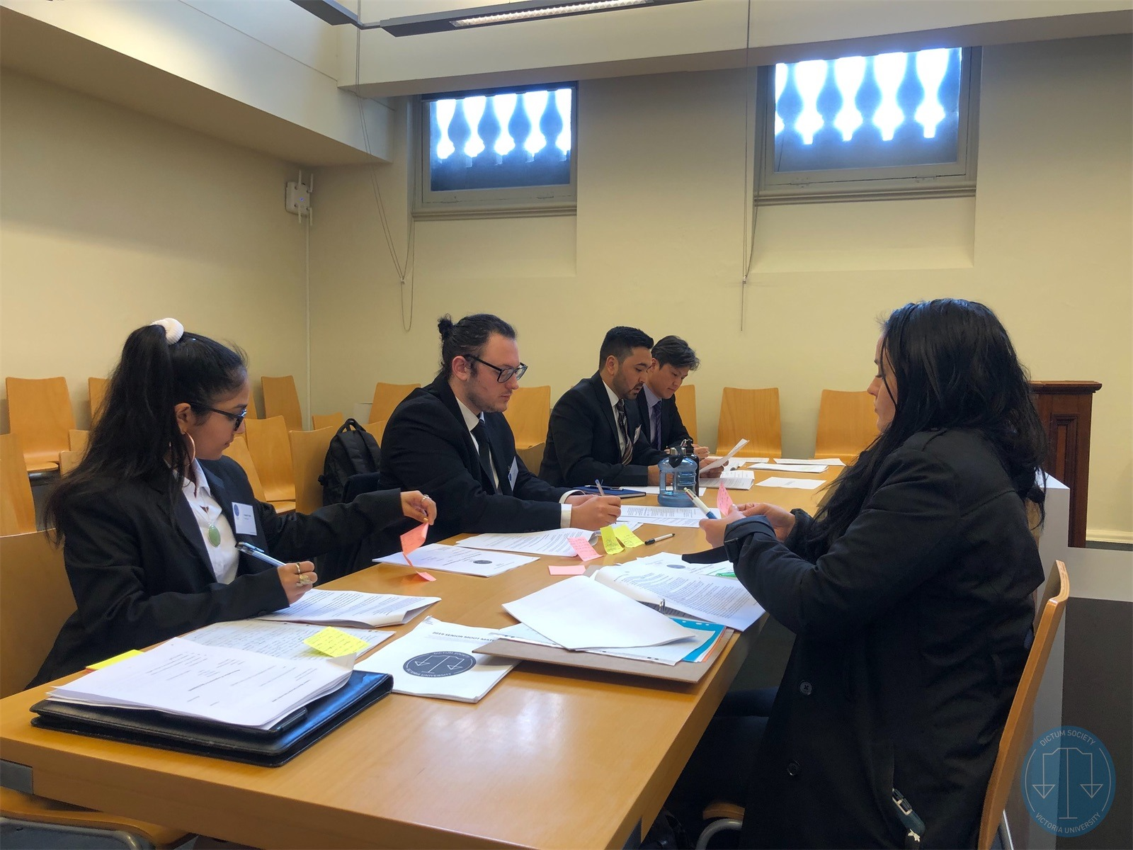
Presentation
Remember that Mooting is a formal environment.
Dress as you would for an appearance in the Courtroom.
Formal Attire!
Notes:
It is important to mention briefly that mooting is a formal environment attempting to mimic a legal courtroom.
Make sure you dress appropriately for the occasion.
I was chewed out in my first moot because I was wearing a coat instead of a suit or tie at the time.
The Judges you encounter later on may have more leniency towards the dress code, or they may be as strict or stricter and request you are dressed more appropriately in future. Be aware of this possibility.

Slide 9
Any questions concerning Mooting Prep?

Slide 10
Practicals of Mooting
Constructing your memorandums
Working through your arguments orally
Signposting;
Guiding Judges; and
Effective Advocacy.
Representing Real People
Properly Conceding a Question
Requesting Feedback

Slide 11
Constructing your Memorandums
Memorandums in the context of mooting are essentially a document containing your research for the problem.
Follow the typical format & expectation for legal writing standards:
An example of this is as follows:
Cover;
Table of Contents;
Index of Authorities;
Statement of Facts;
Outline of Argument;
Argument in Full.
Drafting expects that you will be writing your submission in points, e.g. 1.1, 1.2, 1.3 etc. or 1, 2, 3 etc.
The Legal Writing & Drafting Guidebook for VU is a great help for understanding the exact specifics of drafting these.
Notes:
CONSTRUCTING YOUR MEMORANDUMS: Memorandums follow the typical format and expectation that can be found for legal writing standards. The legal writing class did, and probably still does have the VU custom publication for ‘legal writing and drafting’. I own a physical copy and I’d recommend anyone who’d like to practice up on their ability to at least purview it.
Example of the Format:
Cover/Table of Contents/Index of Authorities/Statement of Facts/Outline of Argument/Argument in Full.
You can deviate from this format, but for the most part that’s exactly what you want to include as a basis.
Memorandum should be short and succinct.
You are essentially outlining your argument, and then addressing the contentious matters of law.
This involves addressing the relevant rule of law, citing statutes and cases, and declaring your conclusion.
It is similar in that regard to a typical legal assignment.
The opposing team you compete against in an actual moot will receive your memorandum and review it against their own, likely with the intention to refine their oral argument.

Slide 12
Example of Formatting (Previously Used Statement of Facts)

Slide 13
Oral Advocacy: Signposting, Guiding Judges & Effective Advocacy
Try to have your speaking points internalised rather than relying heavily on notes.
Outline your submission and state your arguments clearly.
Ensure you are bringing your points back to your overall argument constantly, don’t distract the Judges.
Try to be able to fluidly work through your arguments.
You are addressing the Judges in the moot with the intention of guiding them to your desired conclusion with the aid of the law.
Notes:
WORKING THROUGH YOUR ARGUMENTS: COVER SIGNPOSTING, GUIDING JUDGES, ADVOCACY IN THIS POINT:
Try to avoid reading directly off notes. You’ll be respected more if you can recite your argument without the need for clutches. Having short summary notes that direct your train of thought, supported by the relevant legislation and common law is a very effective and efficient way of handling yourself in a moot. Have your speaking points internalised, when you are presenting your case in the mock court your notes for the most part should be headings that serve to jog your memory for your arguments. Attach cases and relevant legislation, and any explanation or excerpts you require if you are going to quote them.
It is important to effectively signpost during your oral advocacy, make sure you outline your submission, state your arguments clearly and constantly bring your points back to your overall conclusion constantly. Don’t distract the Judges with rambling.
Try to develop the ability to fluidly work through your arguments. It is a difficult skill to hone and understand but the essential understanding stems from the fact that you can and likely will be disrupted in the process of explaining your case by a Judge with a question that you might’ve answered later on in your submission. It is critical not to flounder here, but to carefully consider the question and in your response how you might re-arrange your argument and answer the Judge in a way that’ll satisfy their question and allow you to get back to your point with minimal wastage. It’s difficult to be able to work from your fourth point back to the first, but practice makes perfect for these matters. Don’t worry if you can’t nail this. The entire reason I bring up this point is that I stumbled myself in the final round and struggled in recovery, I asked the Judges for advice afterwards in terms of recovering and working through my arguments better and this is the advice they proposed.
It is also important to remember that Mooting Competitions are not as adversarial as you may think them to be. You are not there to engage in an aggressive debate with the opposing team no matter how riled up you may find yourself while writing your memorandum and sitting down waiting to perform your oral advocacy. You are addressing the Judge with the intention, through the aid of statute & common law with reference to the established situation, to guide them to your desired conclusion.

Slide 14
Representing Real People
In these mock mooting trials, you should act as if these are real people & cases presented to you.
You should be tying the law to the facts, but also the facts to the reality of everyday living when you are advocating for a client.
Creating realistic hypotheticals during your oral advocacy can help to make a more persuasive point.
Notes:
REAL PEOPLE WITH REAL CASES: For the majority of these competitions and mock cases, you are supposed to be representing real people with real cases, and it is important that you respect and empathise this when mooting. If you are defending someone you are representing a person’s most important interests in a court of law. Similarly, if you are prosecuting someone you are the Crown’s agent in protecting the community. Tie the law to the facts, and the facts to the reality of everyday living.
Make sure to establish and reinforce any points that may aid you before the judges, tie it into any provided or likely circumstances.
For instance, the 2019 SNH Criminal Law Moot I participated in concerned a mentally ill Australian veteran, it was an important lynchstone of defending this client that I stressed to the judges that he was as much a victim of circumstances and a terrible environment.

Slide 15
Properly Conceding a Question
You may be caught off-guard and unprepared for a question:
Take a moment if you need to;
Determine if the question can and should be conceded;
You can generally concede a question if doing so will not sabotage your overall submission; and
In certain cases a tactical concession for a minor aspect of your submission can allow you to redirect attention towards the more important matters.
If the question can’t be conceded, you will need to answer the question directly and clearly. Reinforce your belief in your submission here. If necessary, you can concede some weight to the Judge’s probing. How you do this will depend entirely on the specific question.
Notes:
DON’T BE AFRAID TO CONCEDE:
You can be caught off-guard by a question from the Judges or opposing party, don’t be afraid to take a moment to compose yourself (and you can make it clear to the Judge for that that you are requesting a moment) and work through the question instead of having an immediate reactionary response that might weaken your case by rambling.
Determine if the question can and should be conceded; it is extremely important to use discretion when conceding. You certainly don’t want to be conceding everything, especially not where it may cripple your argument, and your language should be carefully decided when you do concede any questions. However, in certain cases a tactical concession for a minor point can allow you to refocus and direct attention towards the more important segments of your argument.
A statement along the lines of “I don’t have an answer for that at this time your honour, I can certainly provide one at a later time with counsel from my client,” is a decent way of responding to a question you can not answer at the moment (presumably because it has caught you off-guard and you don’t have the relevant research for this. Another statement like “Yes, your honour, I will concede that point, however…” can also be a good way to concede a minor aspect, or part of the question while returning back to your submission confidently.

Slide 16
Requesting Feedback
Remember that a significantly important part of mooting is gaining practical experience participating in the legal system.
Judges will likely provide feedback for your arguments as presented, but if they don’t cover something in particular or you find yourself with other questions be sure to ask!

Slide 17
Any questions?
Thank you for attending, I hope you’ve gained some valuable information for your future participation in any mooting events.

